Slide 1
New Horizons Where We Have Been, What Have We Done
Mark Meissner, MD
President
American Vein & Lymphatic Society

Slide 2
The American Veins & Lymphatic Society A History of Progressive Evolution
1985 – North American Society of Phlebology
1997 – Name change to the American College of Phlebology
2005 – AMA recognition of Phlebology as a subspecialty
2006 – Foundation for Venous & Lymphatic Disease (FVLD)
2007 – American Board of Phlebology (now the ABVLM) established
Development of core content for venous & lymphatic training
2007 – First fellowship established (John Bergan)
2008 – First certifying exam
884 diplomates, 5 fellowship programs
2019 – American Vein and Lymphatic Society
Advocacy
Research
Education
Notes:
The American Vein and Lymphatic Society was founded in 1985 as the North American Society of Phlebology with the expressed purpose of bringing together physicians and surgeons from diverse specialties who share an interest in the diagnosis and treatment of superficial venous disease
In 1997, the Society changed its name from the North American Society of Phlebology to the American College of Phlebology to reflect the broadened scope and improved quality of the educational programs
In 2006, the Foundation for Venous & lymphatic disease and the mission was expanded to include recogntion of specialty recognition for venous and lymphatic disease.
This ultimately led to the devlopment of The American Board of Phlebology, now the American board of Venous & Lymphatic Medicine, which now has more that 884 diplomates and oversees 6 fellowship program in venous and lymphatic medicine.
In 2019, the board of directors and membership changed the name to the American Vein & Lymphatic Society to reflect its dedication to the new goals of advocacy, research and education in both venous and lymphatic medicine.

Slide 3
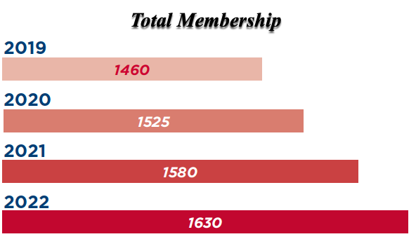
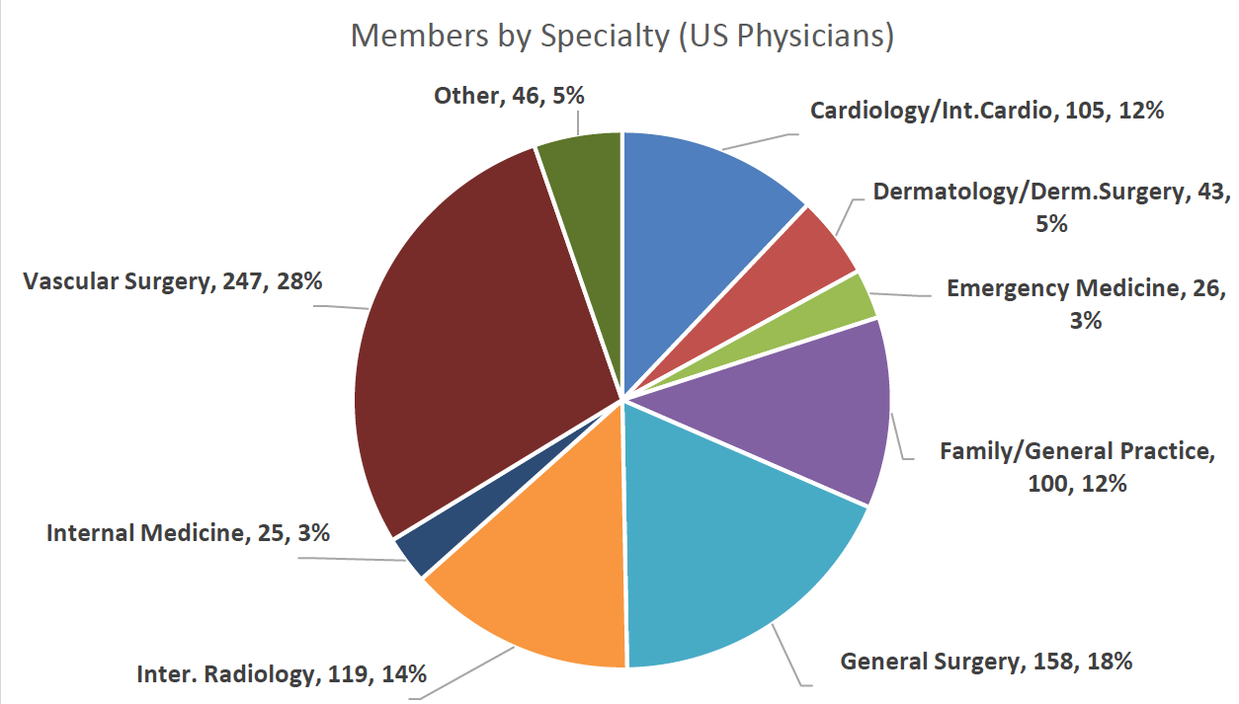
Who Are We?

Slide 4
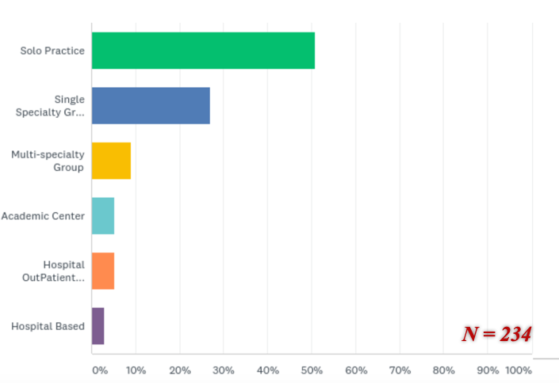
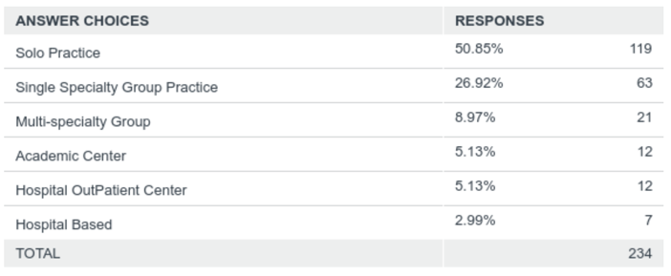
Who Are We ?
Significant Contributions to the Advancement of Venous and Lymphatic Medicine
BUT…
We are NOT just ANOTHER Academic Medical Society

Slide 5
What Makes Us Different Than Other Medical Societies
Collaborative, multidisciplinary membership with a shared vision
Committed, tenured leadership
Executive committee requires minimum of a 12-year leadership commitment
Leadership based on AVLS commitment / involvement NOT academic credentials
The executive committee’s job is to shepherd the strategic plan, NOT to create a new agenda with each incoming president
Agenda based on vetted 5-yr strategic plan

Slide 6
AVLS Strategic Planning A Track Record of Success
2005 - 2010 Foundation for the Future
2011 - 2016 Vision for Tomorrow
Commitment to research in venous disease
PRO registry
2017 - 2022 New Horizons
Advocacy
Research
Education
2022 – Great Expectations

