Slide 1
Scope Of Practice Lines Fade
Mark Meissner, MD
President
American Vein & Lymphatic Society

Slide 2
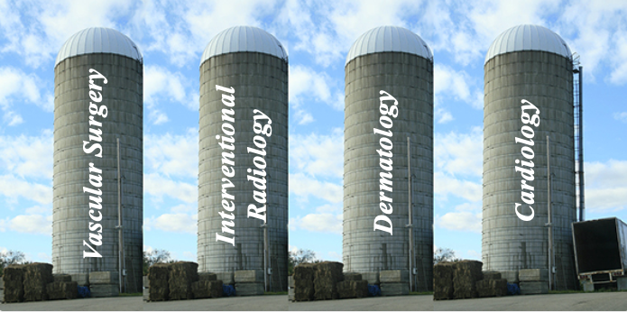
Problem 1 - The Traditional ABMS Paradigm
The American Board of Medical Specialties (ABMS)
24 member boards
40 specialty certificates
88 subspecialty certificates
No new member boards since 1991 (Medical genetics)
Siloed model may work for training, but does not accommodate changes in medical practice or optimally meet a population’s health care needs
Notes:
In principle, medical care in the United states is organized according to the specialty and subspecialty designations of the American Board of Medical Specialties, whose 24 member boards issue 40 specialty and 88 subspecialty certificates. It is important to note that there have been no new specialty boards since 1991. While this siloed approach may work for medical education and training, it does not accommodate changes in medical practice over time or optimally meet the healtcare needs of the US population

Slide 3
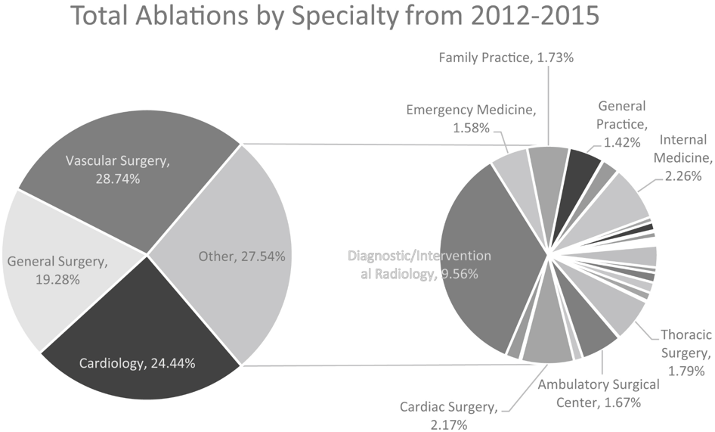
Superficial Vein Care in the United States Crawford JM, J Vasc Surg Venous Lymphat 2019
Medicare Provider Utilization and Payment (MPUP) database 2012-2015
341,750 patients treated by 10, 131 providers
Notes:
This clinical demand mandates care by other than “traditional providers” and at least part accounts for the fact that only about 1/3 and 1/5 of superficial vein procedures are done by vascular surgeons and cardiologists, with the remainder being done by providers from other specialties.

Slide 4
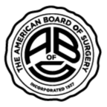
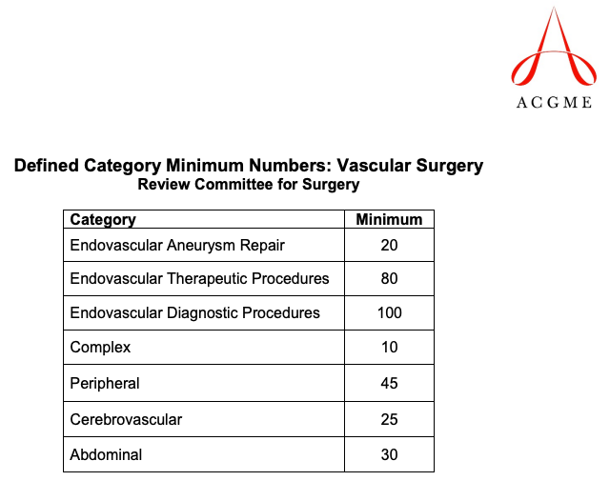
Training in Venous Disease https://apps.acgme.org/ads/Public/Reports/Report/25
No Minimal Case Requirements For Venous Disease !!!
Notes:
Among the ABMS member boards, vascular surgery has traditional claimed ownership of venous disease, particularly superficial venous disease. However, there isn’t a whole lot in the training of a vascular surgeon to back this up. Looking at the ACGME minimal case requirements for vascular surgery,
…venous procedures aren’t even included
And the experience of vascular fellows backs this up, Among the fellowscompeting their training in 2020, the avage number of varicose vein operations was 4.5, …

Slide 5
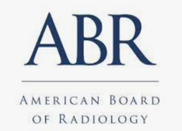
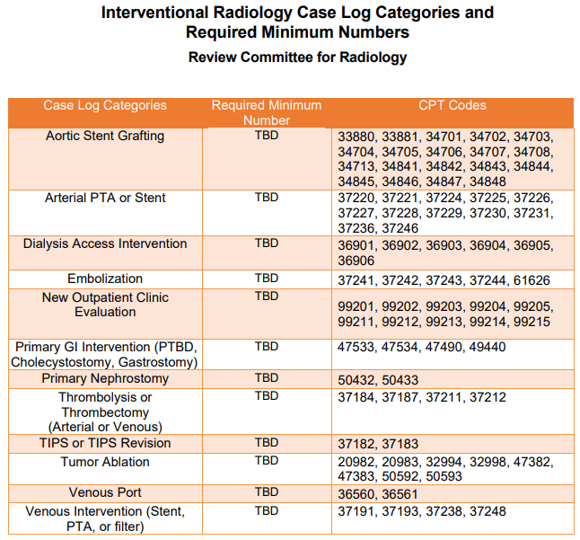
Training in Venous Disease https://www.acgme.org/Portals/0/PFAssets/ProgramResources/IR_Case_Log_Categories.pdf?ver=2018-12-20-135106-953

Slide 6
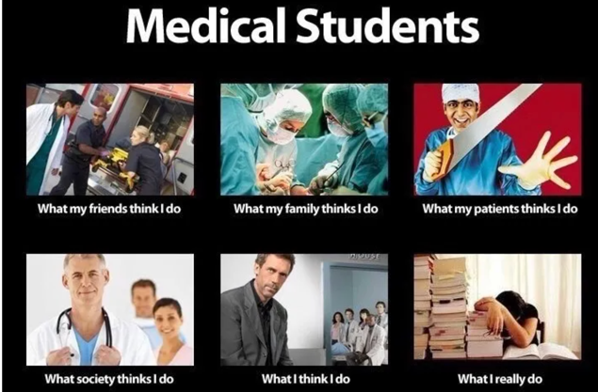
There is currently NO ABMS pathway for adequate venous training

Slide 7
And Does Board Certification Really Matter? Sharp LK, Academic Medicine 2002
Systematic review of 13 studies evaluating relationship between board certification and clinical outcomes
16 positive associations (better outcomes with certification)
3 negative associations (worse outcomes with certification)
14 with no association

Slide 8
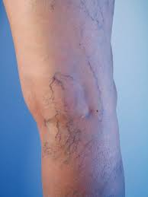
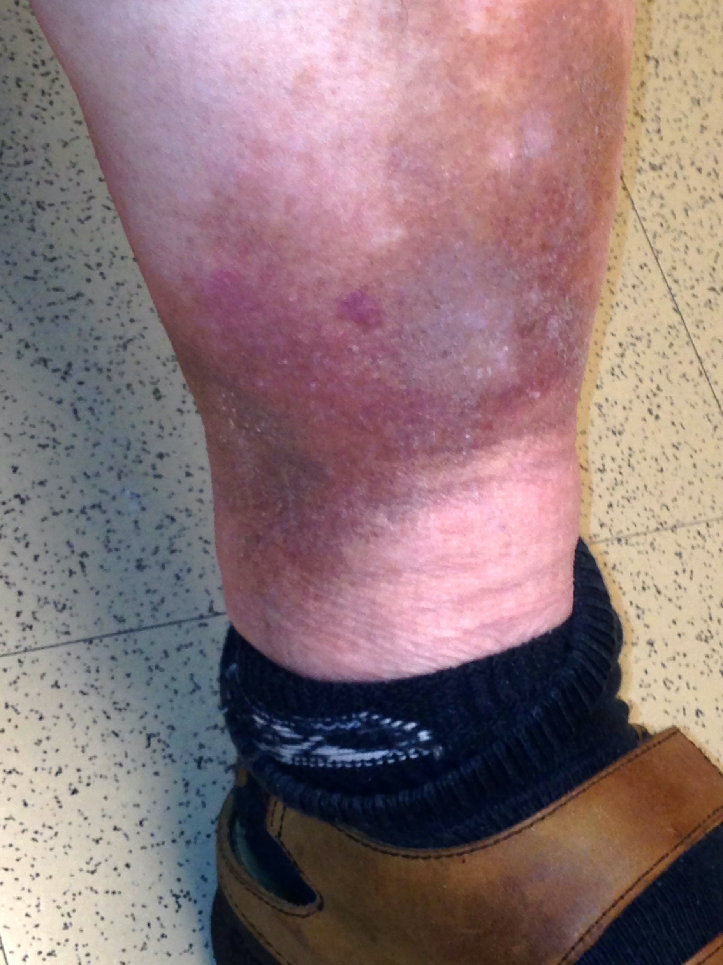
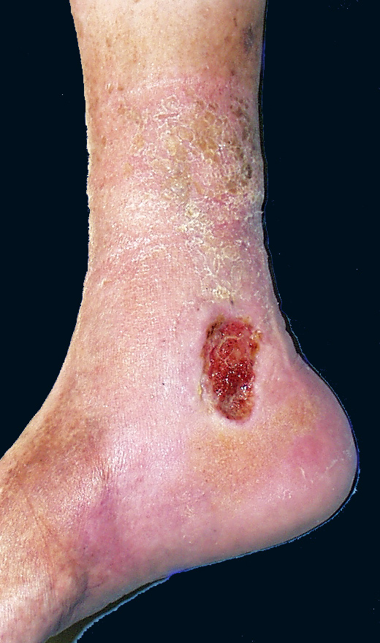
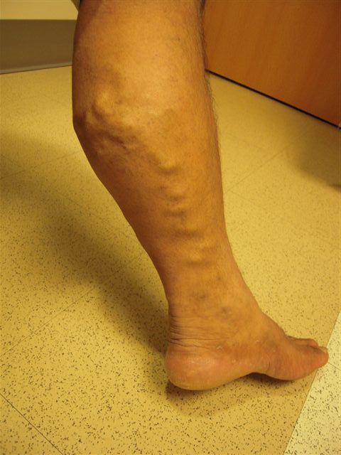
Problem 2 - An Imbalanced Workforce
Epidemiology in the United States
250 million with chronic venous disease
6 – 7 million with advanced venous disease
500,000 – 600,000 with venous ulceration
Traditional Venous “Specialists” (ABMS 2020-2021)
Vascular surgeons – 3,521
Interventional radiologists – 3,453
Interventional cardiologists – 7,179
Venous “Workforce”- 14,153 providers
17,664 patients per provider
495 advanced cases per provider
Notes:
This siloed approach, which may be good for initial training, is not, and never has been a good approach to meeting the healthcare needs of the US population. Consider that there are more than 250 million people with chronic venous disese in the United States, 6 – 7 million of them having advanced venous disease.
..If one applies a fairly liberal definition of what might be considered a “traditional” venous specialist, this might included about 3500 vascular surgeons and interventional radiologists and 7000 cardiologists.
…for a total venous workforce of only 14,000 providers. Assuming all 250 million patients need care, which they don’t, and all specialist devote 100% of their practice to venous disease, which the majority obviously don’t, this works out to almost 18, 000 patients per provider or 495 advanced cases per provider.
It is clear that the workload far exceeds the capacity of traditional providers.

Slide 9
Vascular Medicine
Medical Management
Venous & Lymphatic Disease
Dermatology
Sclerotherapy
Surgery
Medical / Risk Factor Management
Vascular Diagnosis
Superficial Venous
Deep Venous
Lymphatic Disease
Venous and Lymphatic Medicine
Cardiology
Medical / Risk Factor Management
Superficial Venous
Deep Venous
Lymphatic Disease
Phlebology
Medical Management
Vascular Diagnosis
Superficial
Venous
Lymphatic Disease
Radiology
(IR)
PVD
Superficial Venous
Deep Venous

Slide 10
“Plasticity” in Health Care Holmes GM, Academic Medicine 2013
Plasticity
Individual physicians in the same specialty provide a different scope of service (Within-specialty plasticity)
Scope of service of physicians in different specialties may overlap (Between-specialty plasticity)
Overlap between specialties allows increased access to care
Factors influencing scope of service
Patient demand
Service reimbursement
Training background
Physician practice preferences
Why Does The ABMS Recognize Only 88 Subspecialties While The AMA Recognizes 243 (Including Phlebology)?

Slide 11
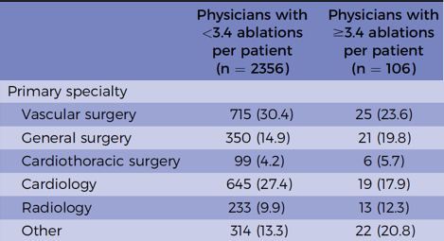
Is There a Difference in Quality of Care? Mann M, J Vasc Surg Venous & Lym Dis 2019
Medicare fee-for-service claims data (January – December 2017)
102,145 patients undergoing ablation by 2462 physicians
Mean 1.9 (± 0.8) ablations per patient
Outliers (+ 2 s.d. above mean) - ≥ 3.4 ablations per patient
Results
“Plasticity” of venous providers
11 – 18 patients / yr – 35.4% of providers
> 35 patients per year – 32.5% of providers
Vascular surgeons less likely to be outliers (p < .05)

Slide 12
We Need To Redefine the Argument
 | N (Physicians) | Mean Ablations / pt | Outlier | % Outliers
Crawford, et al (2019) | 10,131 | 1.6 ± 0.77 | + 1 S.D. (> 2 pt) | 22%
Mann et al (2019) | 2462 | 1.9 ± 0.8 | + 2 S.D. (> 3.4 / pt) | 4.3%
Stonko, et al (2021) | 1558 | 1.89 ± 0.6 | + 2 S.D (> 3.4 / pt) | 5.8%
”Overutilization” usually defined by groups with a vested interest in controlling venous disease
Lawrence PF, J Vasc Surg 2016
But …
Is this Reality and rather reflects increase access to APPROPRIATE care
And…
Does is this view beneficial to anyone (patients, physicians, industry)

Slide 13
III. The Problem of Physician Burnout Coleman DW, J Vasc Surg 2021
Survey of 872 practicing members of the SVS (34.3% response rate)
Maslach Burnout Inventory (MBI) – Validated burnout assessment tool
363 (41.3%) with at least one symptom of burnout
Multivariate predictors of burnout
Work-related physical pain
Work-life conflicts
Work safety concerns
69 (8%) with suicidal ideation within last 12 months
The ABMS paradigm paradigm poorly accommodates life-long physician career pathways
Notes:
Lastly is the problems with ourselves. The Society for Vascular Surgery sponsored a burnout survey of its member. A total of 872 practicing vascular surgeons responded to a validated burnout assessment tool. Among the respondants, 41% had at least one symptom of burnout with predictors in a multivariate model including pain related to ergonomics. Conflicts between work and personal responsibilities, and patient safety concerns at work. It is sobering that *5 of respondants had considered suicide within the past 12 months.

Slide 14
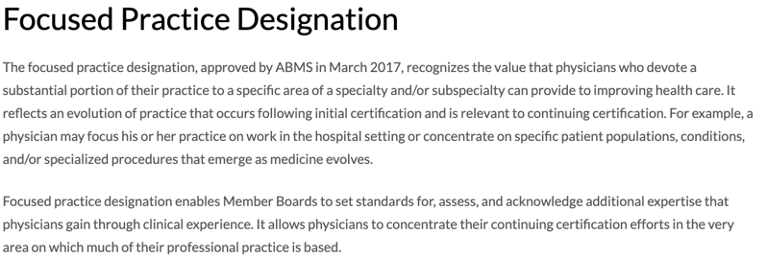
BUT… An Incomplete Answer
FPD remains siloed under individual 1º boards
Participation up to individual primary boards based on diplomate interest
No standardized training paradigm
Does NOT address venous workforce issues

Slide 15
Conclusions
Scope of Practice Lines Fade
U.S. medical practice currently guided by an outdated ABMS paradigm which is poorly responsive to…
Evolution of medical practice
Interdisciplinary fields which cross boundaries of traditional training
Growing health-care needs of the U.S. population
Changes in a physician’s career pathway over a lifetime
A new model is needed that…
Recognizes venous disease as a well-defined sub-specialty of medicine
Provides adequate training in venous disease
Allows long-term career flexibility
…And ABMS Leadership Recognizes This!!!

Slide 17
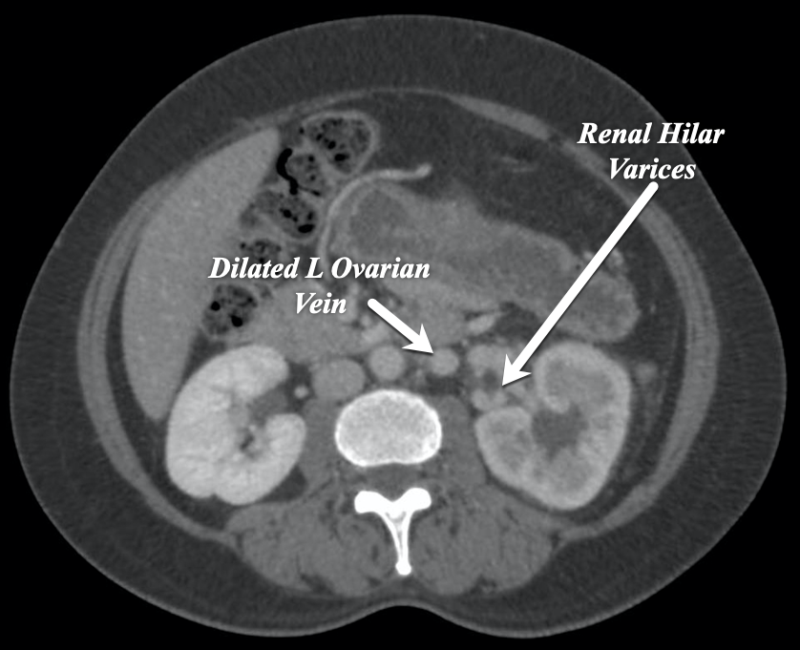
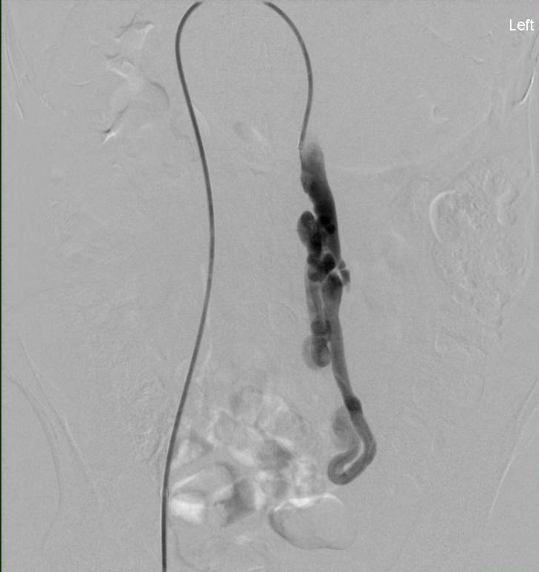
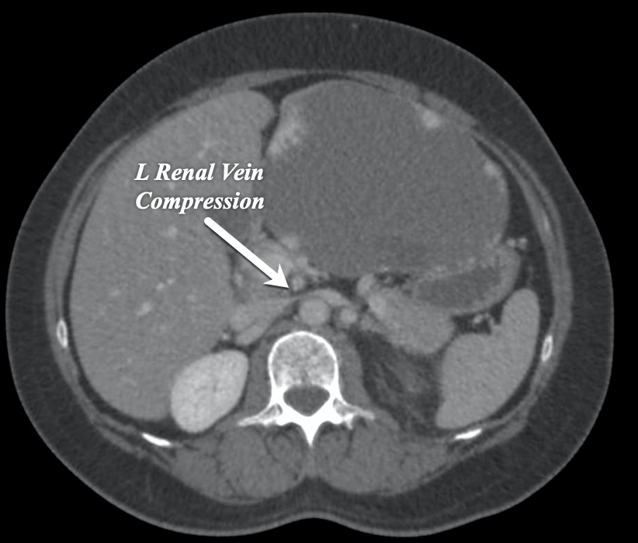
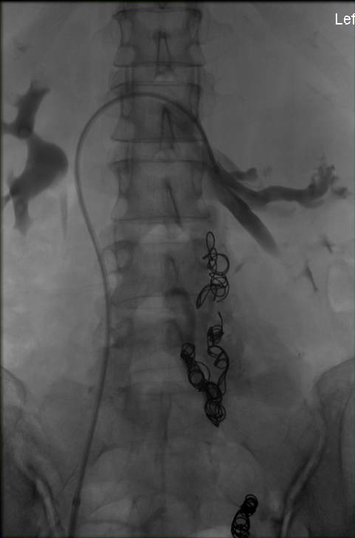
The Current Paradigm DOES NOT Serve Patients
40 yr-old female G3P2 female with 2 yr history of L flank and pelvic pain
Treatment by a “vascular specialist” with left ovarian vein embolization
Compensated converted to Uncompensated L Renal Vein Obstruction
Acute worsening of L flank pain and development of new hematuria
Venography – occlusion of L renal vein
Transrenal pressure gradient – 12 mm HG
Unacceptable Management Errors Are a Daily Occurrence in Venous Practice

Slide 18
Formal training in the entire spectrum of venous disease is imperative
Cognitive skills
Technical / procedural skills
No current specialty is invested in training across the spectrum of venous disease
“On the Job Training” (FDP) is not enough and does not serve the specialty or patients well
Multidisciplinary training is needed and will require investment by all of us
Regardless of posturing, no current ABMS specialty “OWNS” venous and lymphatic disease

