Slide 1
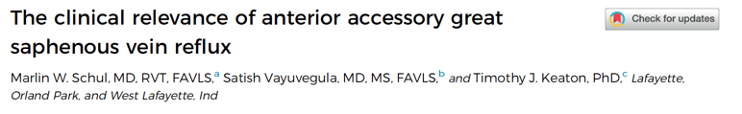
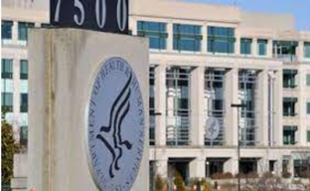
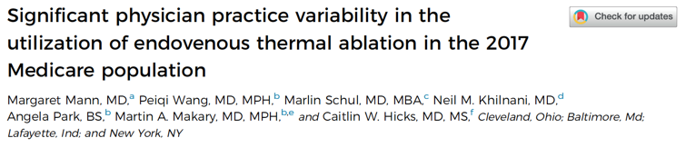
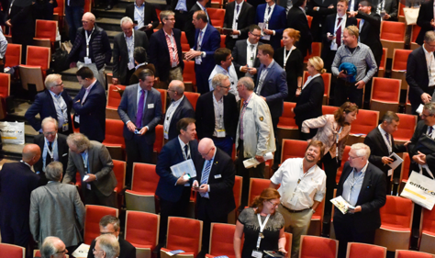
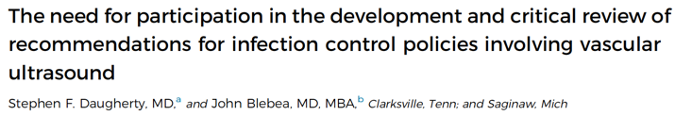
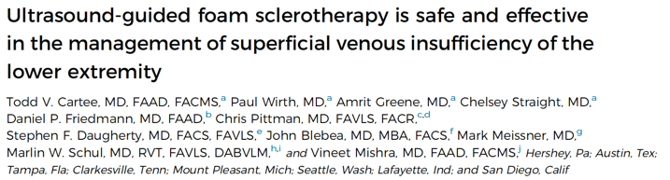
New Horizons
A
R
E
dvocacy
We
esearch
ducation

Slide 2
Advocacy
Research
Education
Advocacy
WE
Target | Response
American Medical Association (AMA) | Phlebectomy task force established in response to 30% cut (2020)
Infrastructure built for effective advocacy
  Full-time Advocacy Director – Robert White
  Board-level Advocacy & Health Policy Committee
  Effective representation at the AMA (HOD, CPT, RUC)
  Relationships established with other societies (AVF, SVS, SIR, OEIS)
CMS | Multidimensional strategy to address clinical labor update and decrease in practice expense
Payers | Effectively lobbied for changes to existing local coverage determinations (LCD)
Congress | Executive member of United Specialists for Patient Access (USPA) Relationships built with key legislators

Slide 3

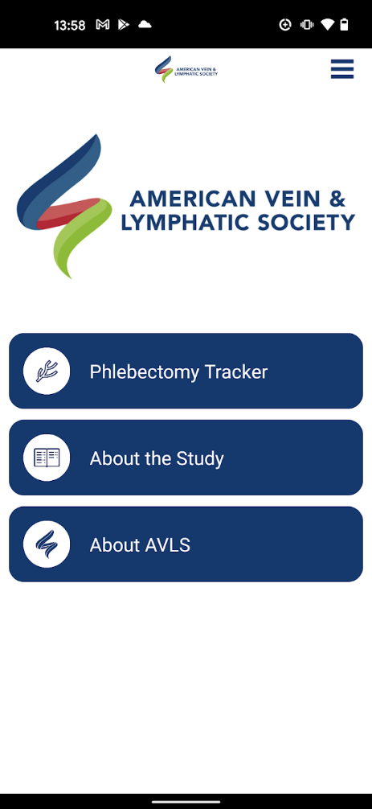
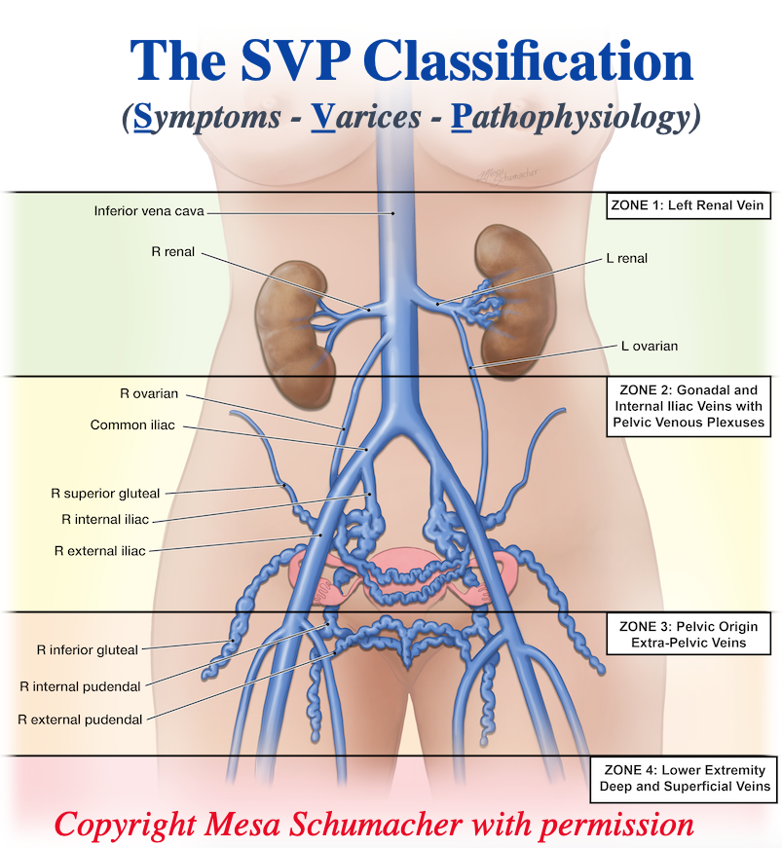
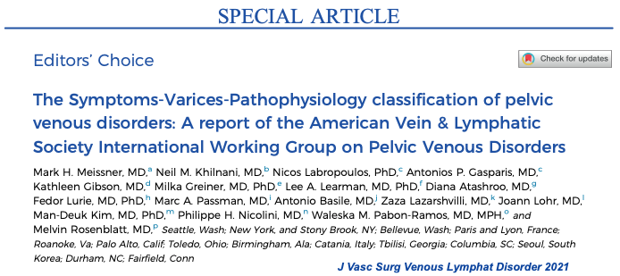
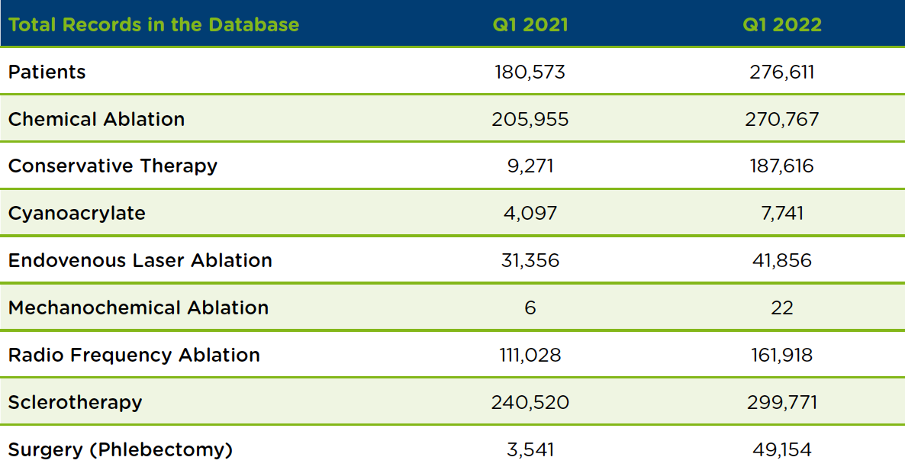
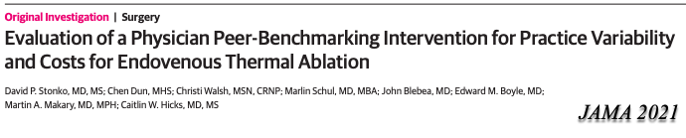
Advocacy
Research
Education
WE
Research
Evidence-Based Guidelines
Guideline | Chair | Questions Developed | Systematic Review Completed | Manuscript Complete
Varicose Veins 1.0 | Gloviczki / Wassan | √ | √ | √
Varicose Veins 2.0 | Gloviczki / Wassan | √
Lymphedema | Fish | √
Pelvic Venous Disorders | Winokur | √
Venous Stenting | Jayaraj | √

Slide 4

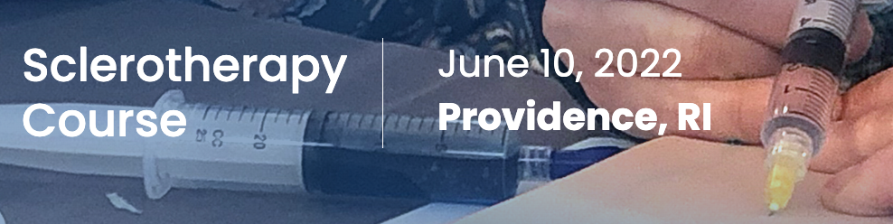

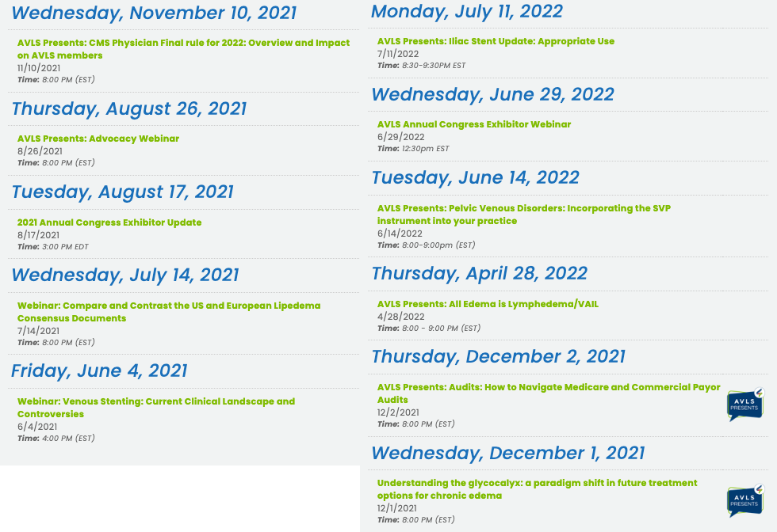
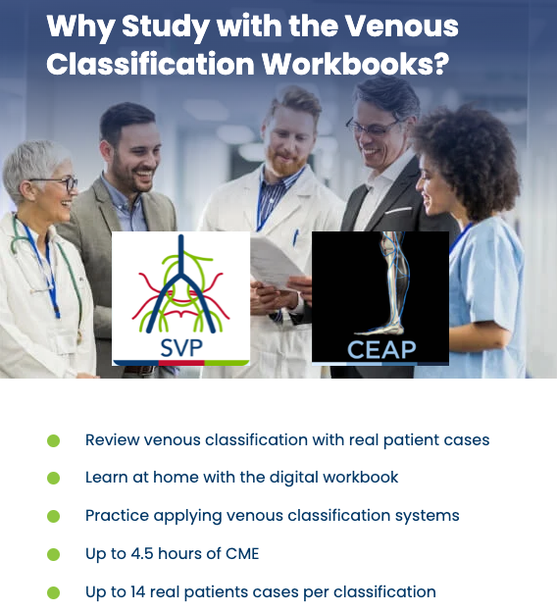
The Acknowledged Leader in Venous Education
Advocacy
Research
Education
Attendees
405 in-person
319 virtual
59 guests
248 exhibitors
WE
AVLS Review Courses – June 2022
Venous & Lymphatic Medicine
RPhS
Sclerotherapy
Education

Slide 6
New Horizons Administrative Commitments
Society renamed the American Vein and Lymphatic Society to better reflect the organization’s expanded mission
Executive director (Dean Bender) hired to execute New Horizons agenda
Full-time staff hired to execute the advocacy & research agendas
  Director of Health Care Policy & Advocacy – Robert White
  Director of Research – Michael Thompson
Headquarters relocated to Chicago
Coalitions with affiliated societies (AVF, SIR, AVF, SCAI, OEIS)

Slide 7

A
R
E
Advocacy
Research
Education
dvocacy
We
We
esearch
ducation

Slide 8
The American Vein & Lymphatic Society:
New Horizons for Advocacy

Slide 9
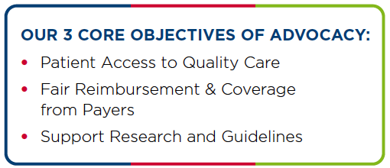
Advocacy & The AVLS
Limited advocacy efforts prior to 2017
“New Horizons” strategic plan – Commitment to advocacy
Board level Health Care Policy & Advocacy Committee
Full-time Advocacy Director – Robert White
Funding for …
  Meetings with government, regulators and payers
  Critical projects and analysis

Slide 10
The Health Care Policy & Advocacy (HPAC) &
Health Care Advocacy Advisory (HAC) Committees
Health Care Policy & Advocacy Committee
Stephen Daugherty, Chairman | Chris Pittman, Vice-Chairman
John Blebea | Vineet Mishra
Steve Elias | Marlin Schul
Mark Meissner
Health Care Advocacy Advisory Committee
Chris Pittman, Chairman | Vineet Mishra, Vice-Chairman | James St. George
Marlin Schul | Margaret Mann | Carl Fastabend
Stephen Daugherty | Lornell Hansen | Theresa Soto
Steve Elias | Robert Worthington-Kirsch | Ken Harper
John Blebea | Zoe Deol | Michael Di Iorio
Mark Meissner | James Albert
Satish Vayavegula | Michael Grave
Ken Nguyen | Francis Lee
Robert Tahara | Dev Batra
Ali Wazni | Marcus Stanbro

Slide 11
The Rock Stars of the AVLS
Robert White
The Hardest Working Band in Medicine

Slide 12

AVLS Advocacy Efforts
The American Medical Association
Centers for Medicare & Medicaid Services (CMS)
Medicare Administrative Contractors (MAC) and Private Payers
United States Congress

Slide 13

The American Medical Association
Phlebology recognized as a distinct subspecialty in 2005
AVLS participation
  House of Delegates – Vineet Mishra
  CPT Editorial Panel
    Satish Vayavegula
    Michael Graves (alternate)
  Relative Value Update Committee (RUC)
    John Blebea
    Marlin Schul

Slide 14
Ambulatory Phlebectomy – The AVLS Response
Phlebectomy codes (2004)
  < 10 incisions (37799, unlisted vascular procedure)
  10 – 20 incision (37765)
  > 20 incisions (37766)
30% cut in phlebectomy reimbursement (2020)
AVLS Phlebectomy Task Force formed to address undervalued physician work
Alternative coding schemes considered based on leg zones (14) rather than number of incisions

Slide 15
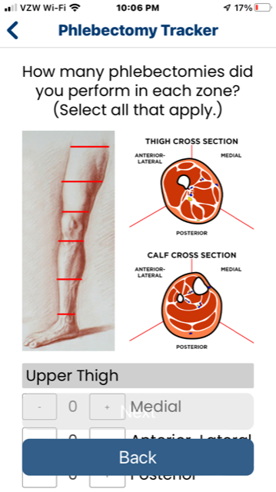
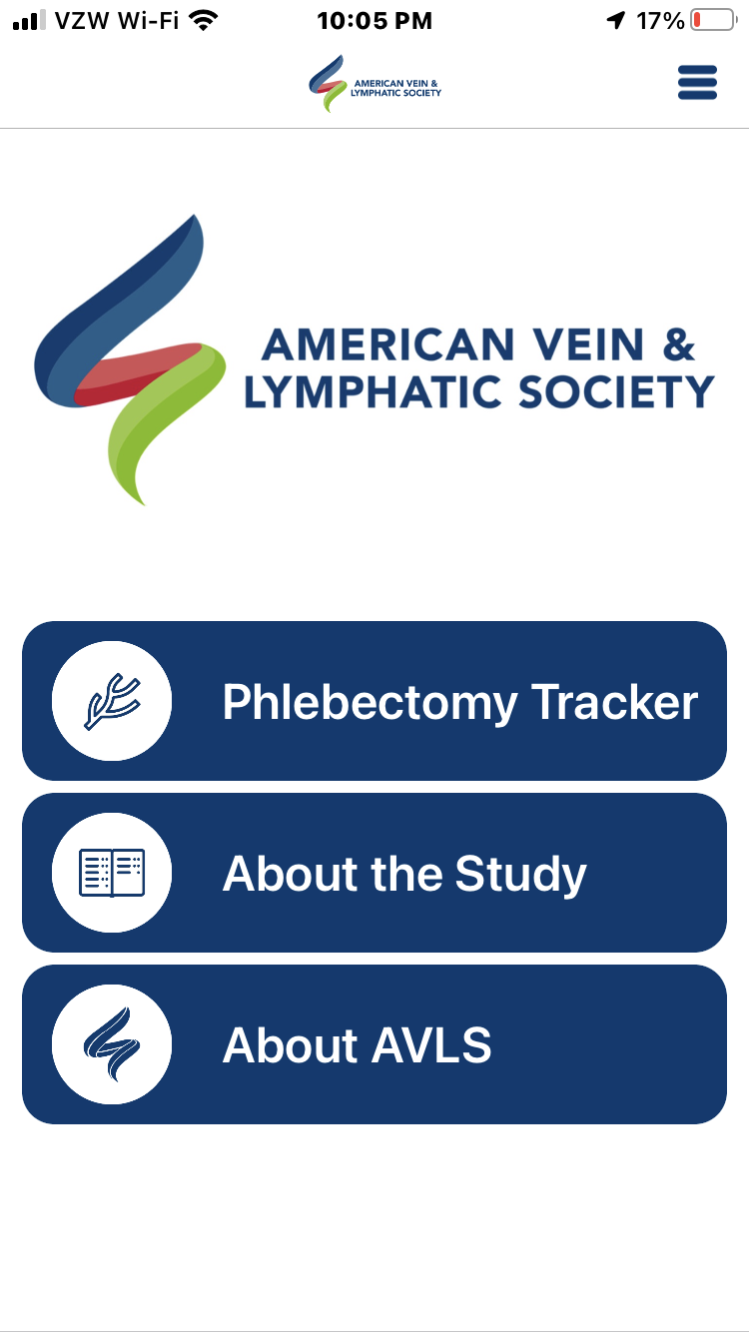
App introduced December, 2021
1,196 case submissions to date
Results to be presented at 2022 Annual Congress

Slide 16
Center for Medicare & Medicaid Services (CMS)
Continuous, real-time monitoring of CMS policy announcements
Rapid response to critical policy updates
Development of a member-funded “War Chest”
  116 donors (96% AVLS members)
  Average gift - $1,096
  Total of $126,000 raised
STOP
CMS-22
ss

Slide 17
Advocacy
Stop CMS-22
Proposed CY 2022 Rule (1751-P)
3.75% decrease in conversion factor
Clinical labor update to Medicare Physician Fee Schedule (MPFS)
Corresponding decrease in practice expense component of MPFS
What This Potentially Meant To Our Members
Average 20% decrease in 9 common venous codes
Overall 12% decrease across all venous & lymphatic services
Critical Threat To Our Member’s Practices, Their Patient’s And The American Vein & Lymphatic Society
Notes:
As all should be aware through our membership communications,the proposed changes to the 2022 Medicare Physician Fee Schedule is going to have a profound impact on our members. In addition to a scheduled 3.75% decrease in the conversion fctor, under budget neutrality updating the clinical labor component of the physician fee schedule will cause a corresponding decrease in the practice expense component of the fee schedule.
implementation of the proposed rule would result in a 20% weighted average reimbursement decreases in nine of the most commonly used venous code, and overall, it is estimated that venous and lymphatic specialists would suffer a 12% decrease in payment across all services between 2021 and 2022. Such dramatic cuts would obviously affect most of our members in office-based practice and threaten the viability of their practices as well as patient access to timely care.
Implementation of the proposed rule would be a critical threat to our member’s practices, their patients and to the AVLS.

Slide 18
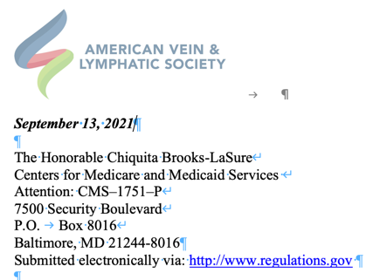
STOP CMS22
The AVLS Response
Congressional Education & Action
Respond
Assess
Cost of shifting care from outpatient to facility setting (Baylor University)
United Specialists for Patient Access (USPA)
Congressional outreach by individual members
Economic impact to vein specialty practices (Braid-Forbes)
Notes:
The AVLS has developed a 3 phase plan to respond to the devastating effect these cuts would have on our membership.
First, 2 studies were commissioned and completed by respected 3rd party analysts – the first examining the financial impact to the healthcare system if the 90% of procedures currently performed in the office shifted to much more expensive facility-based procedures and the second specifically evaluating the impact of the proposed rule on individual venous practices.
This data was used during phase 2 to submit a comment letter to CMS arguing against implementing the proposed rule.
Should CMS decide to implement the proposed rule, we are fully prepared to move on the phase 3 consisting of congressional action. The AVLS has joined the United Specialists for Patient Access , a coalition of office-based specialties fighting to protect physician reimbursement, led by Jason McKitrick and Liberty Partners, a contracted lobbying firm. This group will target congress regarding the effects of the proposed rule. However, in addition to this effort it is vitally important that our individual members contact and work with their congressional delegation to pass legislation restoring a fair payment schedule.

Slide 19
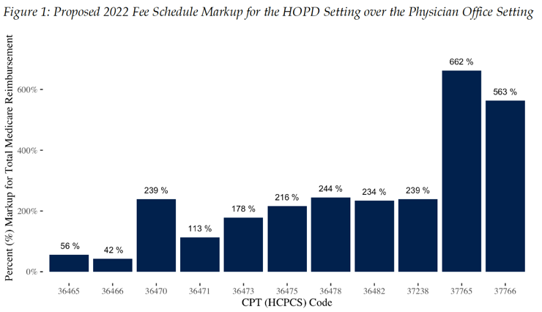
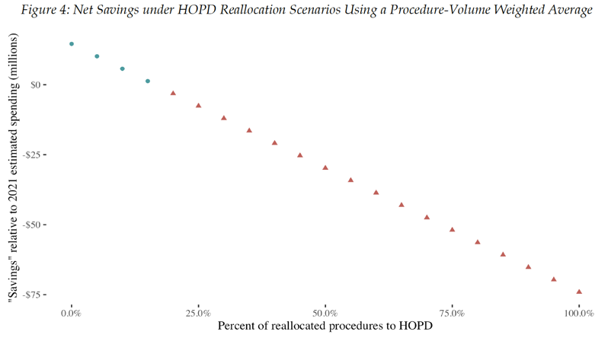
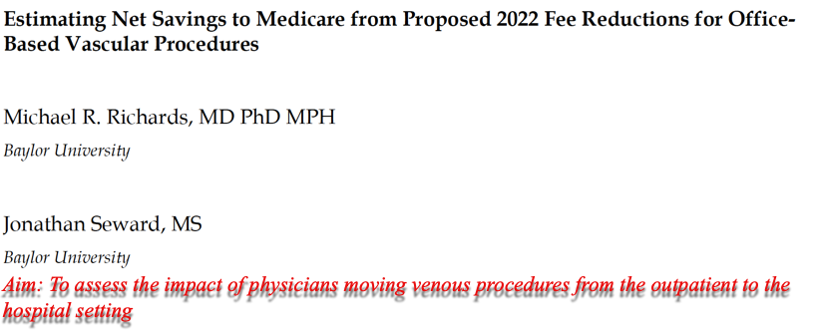
Assess
Braden-Forbes Study Aim: Assess the impact of CMS CY22 on Venous & Lymphatic Medicine if a recognized specialty
Specialty | 2022 | 2025
VLM | -6.4% | -14.2%
IR | -6.6% | -14.3%
Vascular Surgery | -6.3% | -12.8%
General Surgery | -1.8% | -5.3%
Pediatrics | -1.4% | -4.5%
Family Medicine | -1.0% | -3.2%
NC Foam, Multiple Veins
Phlebectomy, 10 - 20

Slide 20
The Outcome in 2022
4-yr phase in of clinical labor update (variable, but approximately 5%/yr)
Congressional action to increase conversion factor to $34.61 (3% increase)
  Expires 12/31/22
  CY 2023 – Scheduled decrease to $33.08 (- 4% decrease)
6 – 8% decrease in vein specific codes (versus 14.2% predicted)
At best …A stay of execution
But…
Established the AVLS as a player in advocacy
Membership educated about meaningful political action
Coalitions built for the future (AVF, SVS, SIR, OEIS)

Slide 21
The Payers
General AVLS Advocacy Principles
Support evidence-based treatment based upon guidelines and expert opinion when guidelines do not exist
Support access to appropriate care while supporting tools for payors to limit clearly inappropriate care
Support care by qualified physicians of all specialties
Support all appropriate sonographer credentials—RPhS, RVT, RVS
Remove mandatory compression trials as criteria for treatment while supporting the value of compression as an important component of patient management
Support mandatory venous evaluation for patients with venous leg ulcers
Support for NTNT
Courtesy of Stephen Daugherty, MD

Slide 22
The Payers
The Problems
Ambiguous LCD Language
Selective use of literature & guidelines
Overly restrictive policies
General supervision of mid-level providers
The AVLS “Ask”
Coverage of NTNT
Coverage of UGFS
The Response
Conservative care waived for VCSS ≥ 6
Coverage of IPC treatment for local pain / tenderness
USGFS covered for C_{2 – 6} disease
Coverage for MOCA & cyanoacrylate
Courtesy of Stephen Daugherty, MD

Slide 23

Other Payers
Phlebectomy / UGFS not included in indicated procedures
Liquid sclero covered for 3 – 6 mm veins
No procedure listed for > 6 mm veins
Allowance for only 3 sclero sessions / leg
RPhS and RVS not included in U/S credential
Venous Stenting
Limited coverage for venous stenting (LCD withdrawn)
No coverage for office-based stenting (clarified)
No requirement for IVUS
Courtesy of Stephen Daugherty, MD

Slide 24
Congress
Priorities
Congressional remedy for the clinical labor update
Reform of budget neutrality mandates
Strategy
Membership education & direct interaction with their legislators
Executive member of United Specialists for Patient Access (USPA)
Political consultants to navigate the legislative / regulatory process

Slide 25
”New Horizons” Mission Achieved
Advocacy
Research
Education
WE
The Required Infrastructure Has Been Built & Tested
Membership engagement in the political and regulatory process
Resources are now in place to effectively interact with
  The American Medical Association (AMA)
  Centers for Medicare & Medicaid Services (CMS)
  Payers
  Congress

