Slide 1
AVLS PRO Venous Registry
State of the Asset
July 23rd, 2022

Slide 2
Primary Purpose of the Registry
Advocacy
Patient Level
Use data to support standards in care
Use data to support reimbursement for a condition
AAGSV Manuscript
Prevalence of surgically correctable reflux in VLU
Provider Level
Use data to support reimbursement
AP Task force/Phlebectomy App/SVP App
Benchmark Dashboard
Ablation/limb
Compliance with reporting standards

Slide 3
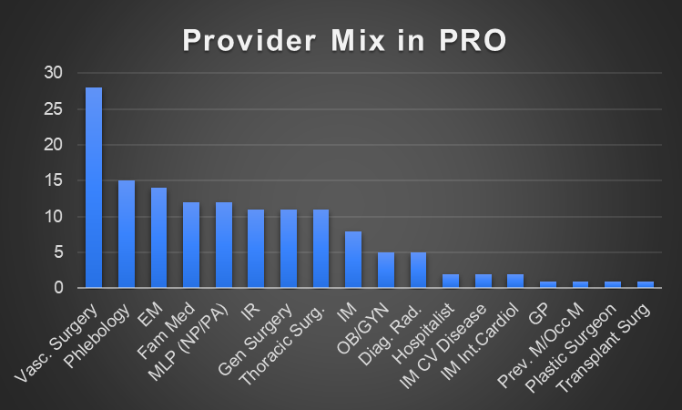
Who is in PRO?

Slide 4
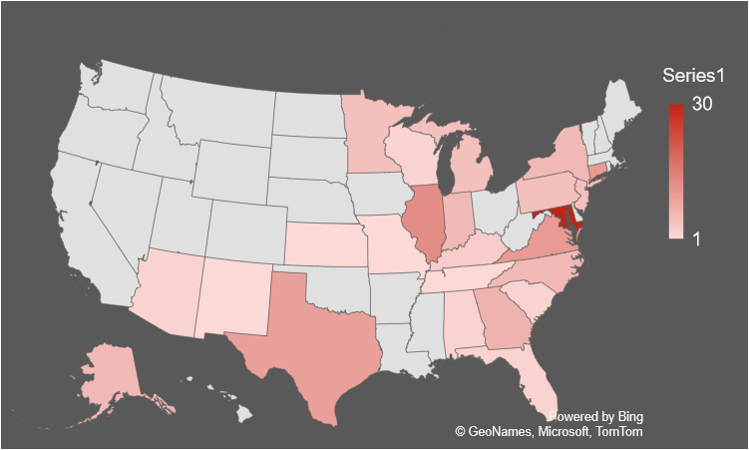
Heat Map of Participants

Slide 5
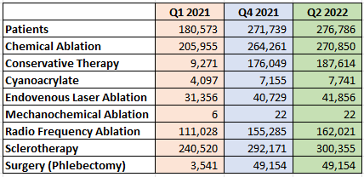
Growth Over the Past 18 Months

Slide 6
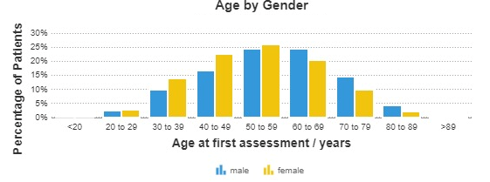
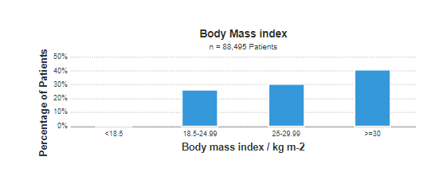
Patient Demographics

Slide 7
AVLS Research Project Updates
Venous Leg Ulcer Study
Purpose: Structural barriers to vein care for those with venous leg ulcers. What percentage of patients entering a dedicated vein practice have surgically corrected disease?
Methods: AVLS PRO database queried for all C6 patients January 2018 thru January 2022. Presence of ulcer was further correlated by crossing the N of ulcers in same limb. Demographics, rVCSS, rVCSS features (duration of ulcer/compression compliance), and index duplex findings.
Results: More than 270,000 were reviewed resulting in 1,794 (0.66%) unique patients (1,878 limbs), 993 (55.4%) males, 799 (44.6%) females. Isolated superficial reflux was found in 68.7%. Group with mixed pathology revealed 238 (12.7%), and those with isolated deep vein pathology 58 (3.1%). Fifteen percent of wounds had no venous pathology
Conclusion: Eighty five percent of leg wounds in this study are related to venous pathology, and 97% possess surgically correctable disease.

Slide 8
AVLS Research Project Updates
Venous Leg Ulcer Study
 | Superficial Vein Pathology (1291) | Mixed Deep and Superficial (238) | Deep Vein Pathology (58) | No Vein Pathology (292)
Age (Mean/Median) | 64.2/65.0 | 62.1**/63.0 | 66.8/64.0 | 66.0/67.0
Sex Ratio F:M % | 45.8:54.2 | 31.5***:68.5 | 37.9:62.1 | 48.3:51.7
BMI (Mean/Median) | 35.1/33.4 | 32.8**/31.1 | 31.7/29.4 | 35.5/34.2
Race (White/Black/Latino/Other) % | 71/16/6/7 | 65/17/9/9 | 62/21/3/15 | 52/21/15/12
rVCSS (Mean/Median) | 13.1****/13 | 13.8****/14 | 12.3/12 | 11.7/11
Duration of Ulcer (rVCSS values 0, 1, 2, 3) % | 29/36/27/8 | 28/23/37/12 | 26/37/26/11 | 29/39/23/10
Active Compression (rVCSS values 0, 1, 2, 3) % | 33/16/18**/34** | 25/14/17**/43** | 34/23/11/32 | 44/18/13/26
** denotes p < 0.05; *** denotes p < 0.001; and **** denotes p < 0.0001

Slide 9
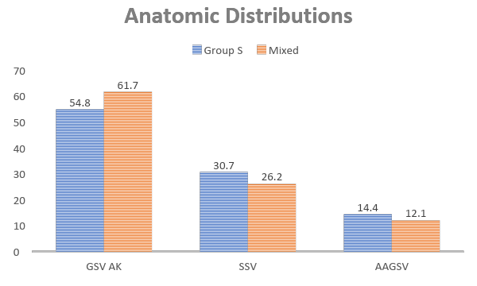
AVLS Research Project Updates
Venous Leg Ulcer Study

Slide 10
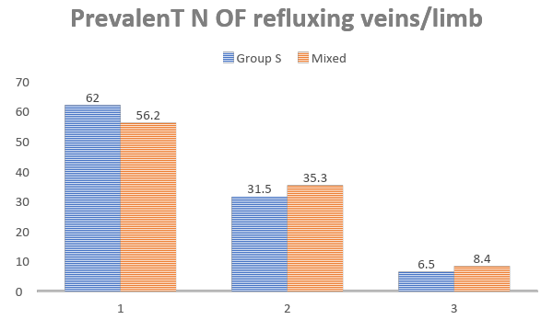
AVLS Research Project Updates
Venous Leg Ulcer Study

Slide 11
AVLS Research Project Updates
Venous Leg Ulcer Study
85% of wounds entering a dedicated vein center have a venous disorder
97% of venous leg ulcers have an axial vein eligible for ablation
15% have non venous causes presumed related to arterial, lymphedema, malignancy, etc.
Barriers remain to access vein care and ulcers demand more than wound care
We conclude that given the complexity and prevalence of reflux in the VLU population, early referral to dedicated vein centers will help to effectively triage patients and prove a valuable component to a multidisciplinary team.

Slide 13
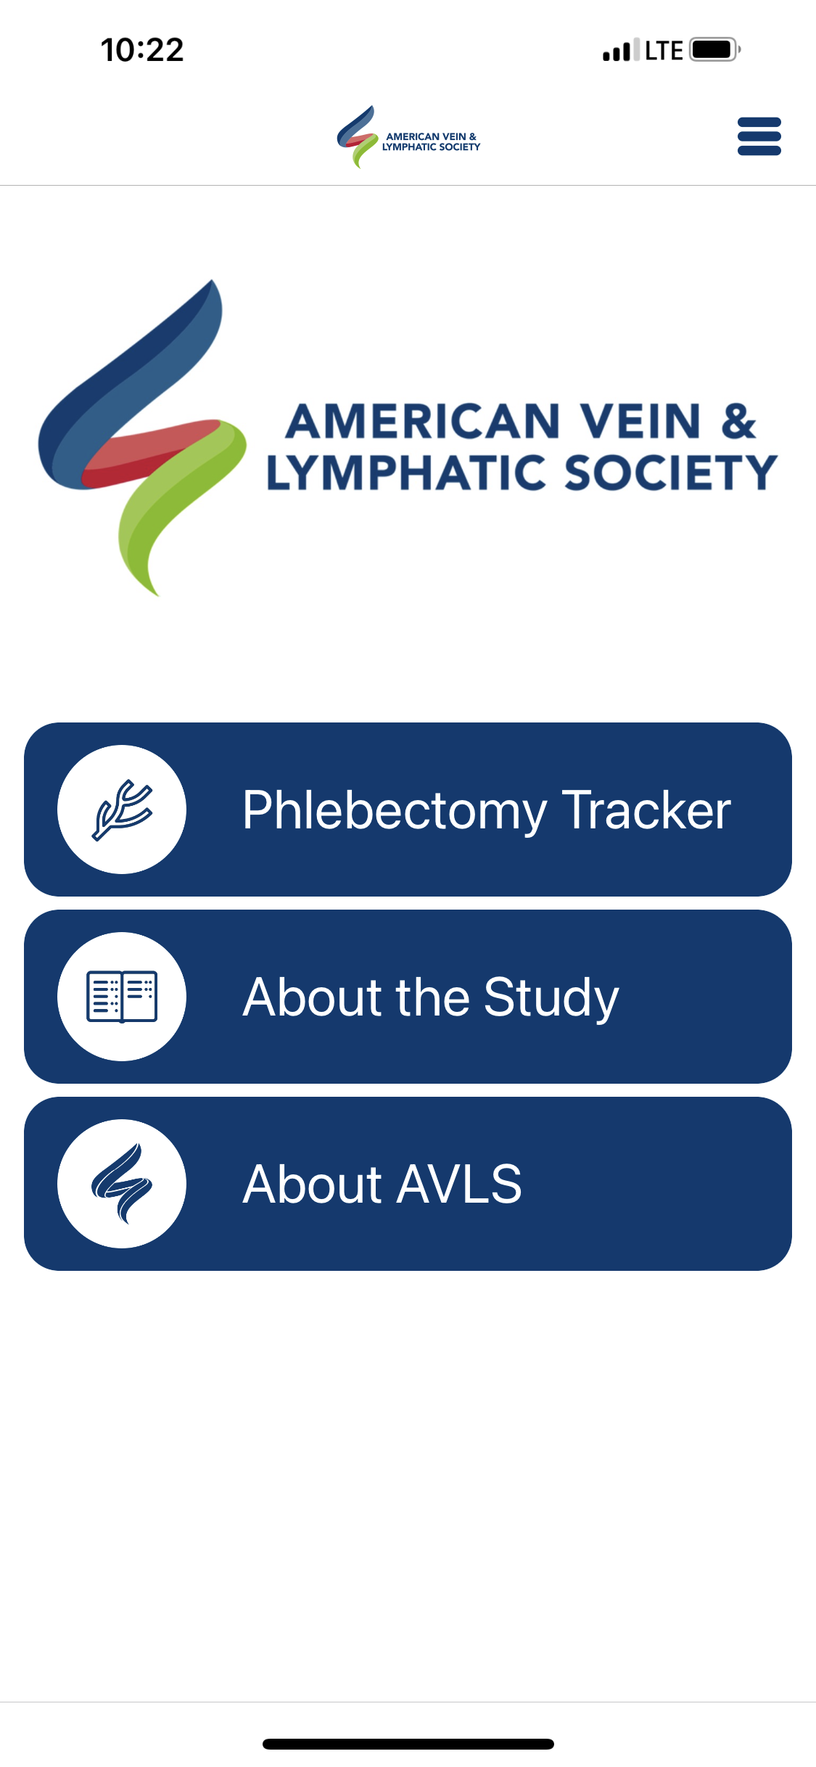
AVLS Research Project Updates

Slide 14
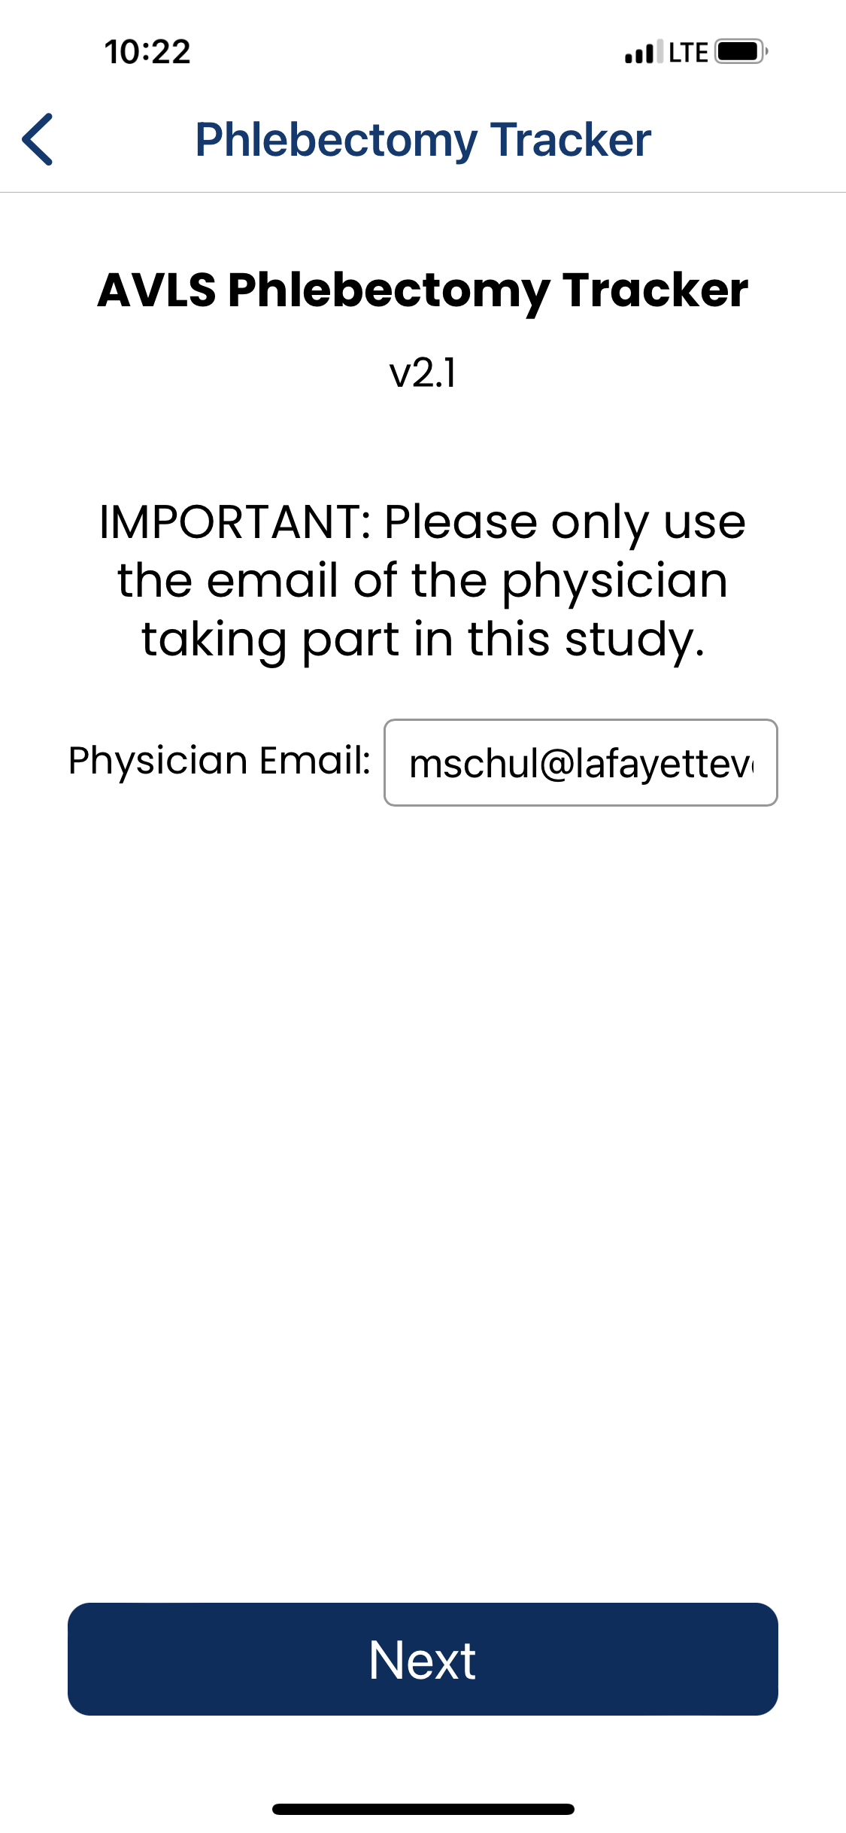
AVLS Research Project Updates
Ambulatory Phlebectomy Mobile App
Purpose: Phlebectomy coding is archaic by nature. This study sought to evaluate features of ambulatory phlebectomy by zones of treatment and time required and correlation with underlying pathology.
Methods: AVLS Tracker App provided free of charge to reporting providers. (8) Web pages describing procedures performed. Data was analyzed blinded to patient and provider.

Slide 15
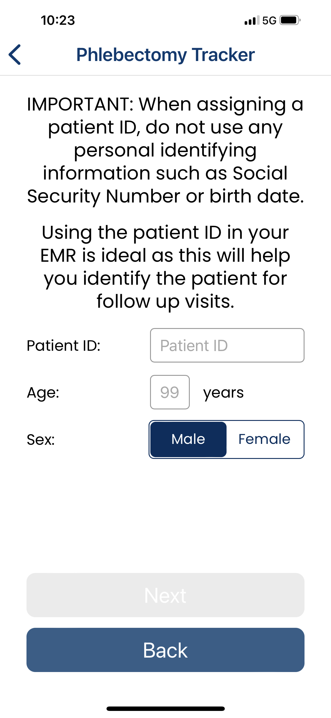
AVLS Research Project Updates
Ambulatory Phlebectomy Mobile App
Purpose: Phlebectomy coding is archaic by nature. This study sought to evaluate features of ambulatory phlebectomy by zones of treatment and time required and correlation with underlying pathology.
Methods: AVLS Tracker App provided free of charge to reporting providers. (8) Web pages describing procedures performed. Data was analyzed blinded to patient and provider.

Slide 16
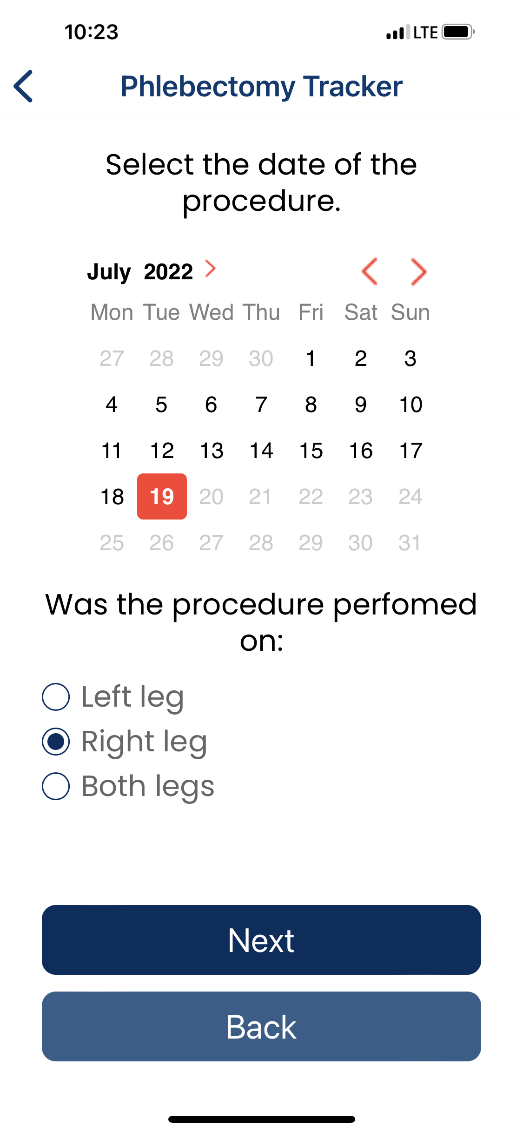
AVLS Research Project Updates
Ambulatory Phlebectomy Mobile App
Purpose: Phlebectomy coding is archaic by nature. This study sought to evaluate features of ambulatory phlebectomy by zones of treatment and time required and correlation with underlying pathology.
Methods: AVLS Tracker App provided free of charge to reporting providers. (8) Web pages describing procedures performed. Data was analyzed blinded to patient and provider.

Slide 17
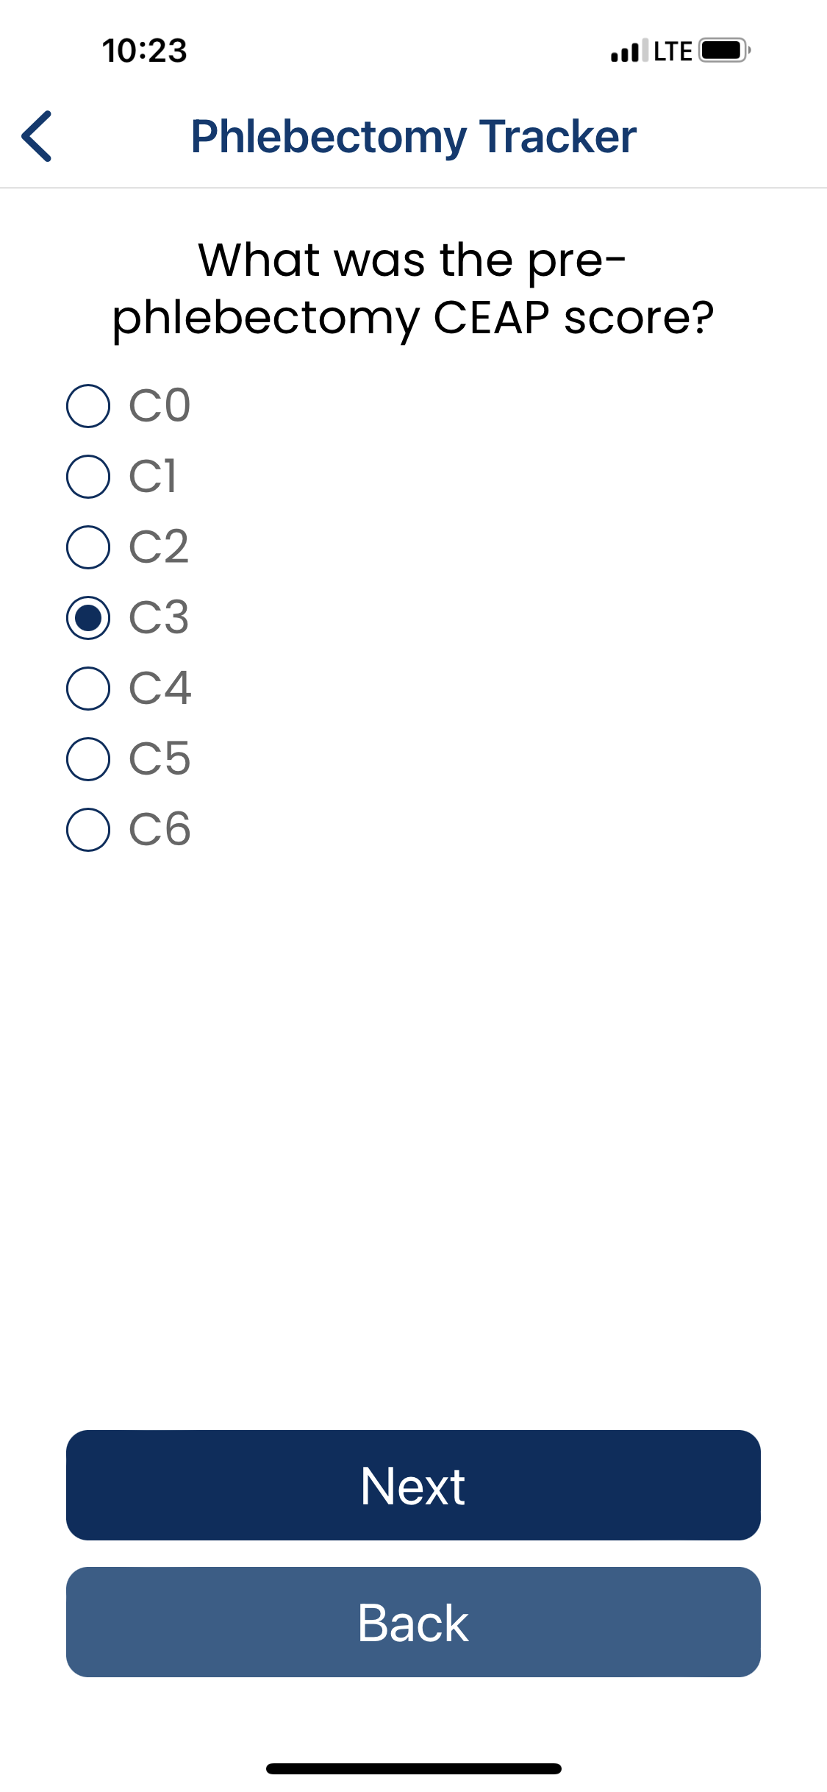
AVLS Research Project Updates
Ambulatory Phlebectomy Mobile App
Purpose: Phlebectomy coding is archaic by nature. This study sought to evaluate features of ambulatory phlebectomy by zones of treatment and time required and correlation with underlying pathology.
Methods: AVLS Tracker App provided free of charge to reporting providers. (8) Web pages describing procedures performed. Data was analyzed blinded to patient and provider.

Slide 18
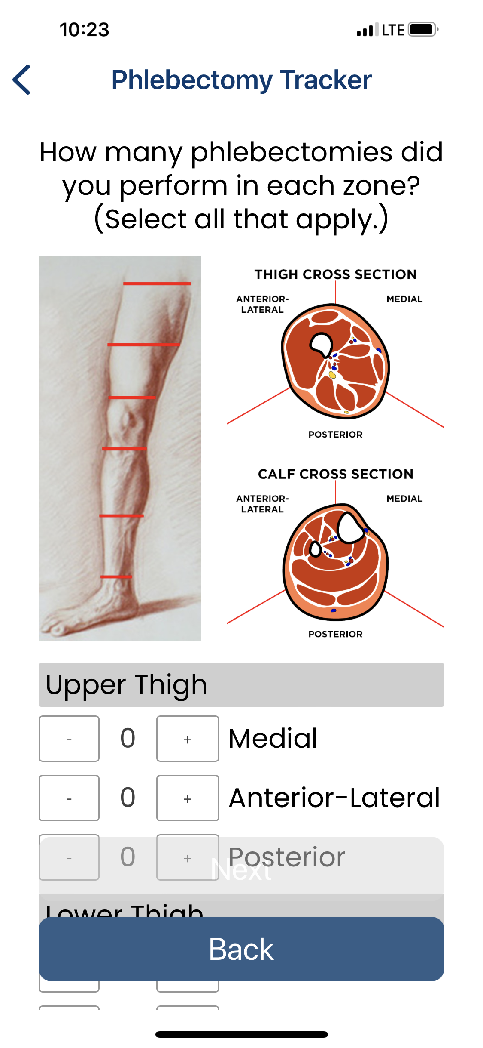
AVLS Research Project Updates
Ambulatory Phlebectomy Mobile App
Purpose: Phlebectomy coding is archaic by nature. This study sought to evaluate features of ambulatory phlebectomy by zones of treatment and time required and correlation with underlying pathology.
Methods: AVLS Tracker App provided free of charge to reporting providers. (8) Web pages describing procedures performed. Data was analyzed blinded to patient and provider.

Slide 19
AVLS Research Project Updates
Ambulatory Phlebectomy Mobile App
Purpose: Phlebectomy coding is archaic by nature. This study sought to evaluate features of ambulatory phlebectomy by zones of treatment and time required and correlation with underlying pathology.
Methods: AVLS Tracker App provided free of charge to reporting providers. (8) Web pages describing procedures performed. Data was analyzed blinded to patient and provider.
Results: A total of 1,196 phlebectomy cases were recorded by 27 physicians December 2021 thru July 2022. Women 68% (810/1,196) and mean age 57 +/- 14 years.
Right/Left 607(51%)/576(48%). CEAP Class Distribution C2 67%, C3 20%, C4 11%, C5 0.9%, and C6 0.5%.
Total of 21,132 phlebectomy incisions were performed: AK 39%, BK 52%, Knee 8%, and Foot 1% distributed over 14 zones of the lower extremity.
Average time to complete phlebectomy 67 +/- 40 minutes with a median of 60 minutes. Mean phlebectomy incisions per case was 34 +/- 25 and median of 27 (1-146).
Average Operative Time per incision was 3.3 +/- 5.3 minutes with median of 2.0.
Conclusions: App was developed and effective in capturing large volume data. Large variation in both the number and time needed to perform AP indicates great variability and suggests reimbursement policies should be based upon more than just the N of incisions.

Slide 21
AVLS Research Project Updates
Epidemiology of 276k Unique Patients Visiting Dedicated Vein Centers
166,650 with duplex information
133,468 W (80.1%) / 32,883 M (19.8%)
Age Range 11-108; Mean 55 years (0.1% missing)
BMI Range 15.1-79.1; Mean 30.2 (55.9% missing)
Race 71.5% White, 11.1% Black, 9.3% Hispanic, 8.1% Other (>30% missing)
rVCSS Range 1-26 (61.7% missing)
Prior treatment 10.5% ; De Novo Patients 89.5%
Patient Mix: Isolated SVI 134,555 (80.7%); Isolated Deep 909 (0.5%); Mixed 11,490 (6.9%); No Vein Disorder 19,606 (11.8%)
Eligible ablations per limb by group: Isolated SVI 1.3 ablations/limb; Mixed 1.4 abl/limb

Slide 22
Considerations moving forward
Status on providers
Expand geographic footprint (Increase heterogeneity)
Consider report cards for participating providers using utilization standards
Critical data for any vein patient, e.g rVCSS
% completing HRQL queries over time
N patients treated/seen
N ablations/limb
Complications Reporting - % post procedure reports
Project Pipeline
Rebuild writing groups
Continue low hanging fruit studies -Talosix
Begin comparative effectiveness studies with true economic impact of care, e.g. SF-6D
Consider running epidemiology comparisons using SF-6D and seek correlation to HASTI, rVCSS, etc. to help standardize what is important to capture

Slide 23
Thank you!
mschul@lafayetteveins.com
(765) 479-4216

